Slide 1


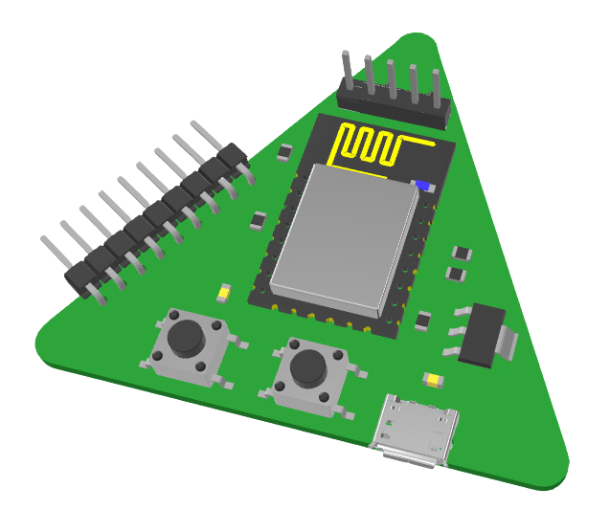

BUCO PI:
BASICS AND DEMO
BATSTATEU CUSTOMIZABLE AND OPEN PLATFORM FOR IOT
Presented By:
Marc James Beltran

Slide 2
OBJECTIVE
Introduce the basics of BUCO PI and demonstrate a simple project.
By the end of this session, participants should have a foundational understanding of BUCO PI and be able to replicate the demonstrated project on their own.

Slide 3

Parts, IO pins, Basic Application, and
Software & Hardware Requirements
INTRODUCTION
Live Demo 1
OLED DISPLAY CODING USING BUCO PI
Live Demo 2
WEBSERVER CODING USING BUCO PI
HANDS ON EXPERIENCE
CREATING YOUR OWN

Slide 4



WHAT IS BUCO PI?

Slide 5
WHAT IS BUCO PI?
BATSTATEU CUSTOMIZABLE AND OPEN PLATFORM FOR IOT
The BUCO PI is a circuit board designed for various electronic projects. It offers a wide range of capabilities and can be used for creating innovative projects, including Smart devices, robotics and more.

Slide 6
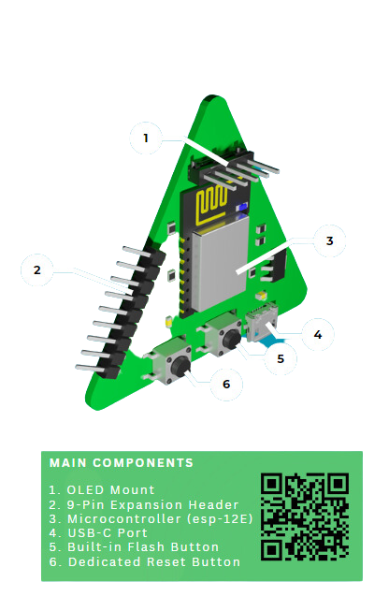
BUCO PI
PARTS
BATSTATEU CUSTOMIZABLE AND OPEN PLATFORM FOR IOT
Main Components
1.OLED Mount
2.9-Pin Expansion
3.Microcontroller (Esp-12F/E)
4.USB-C Port
5.Built-In Flash Button
6.Dedicated Reset Button

Slide 7
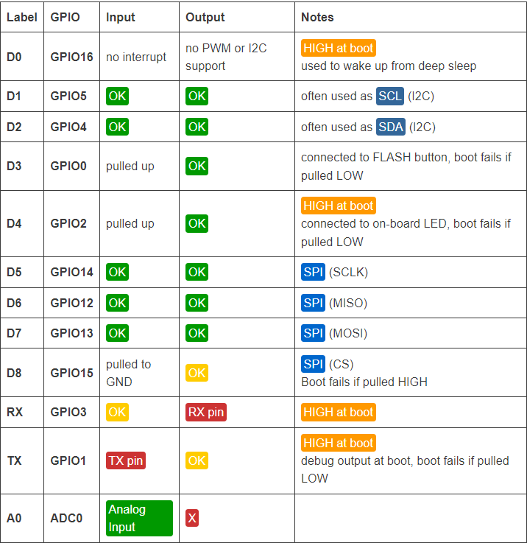
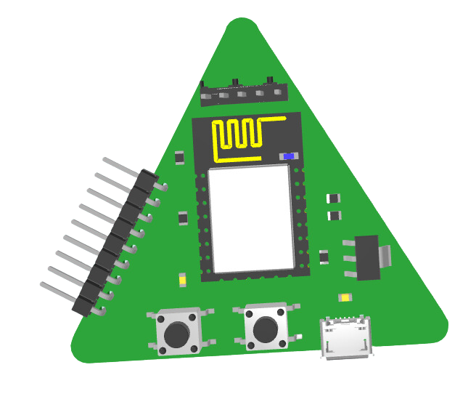
BUCO PI
I/O Pins
BATSTATEU CUSTOMIZABLE AND OPEN PLATFORM FOR IOT
15 - 14 - 12 - 13 - TX - RX - 3V3 - 5V
GND - 5V - SCL - SDA
Table 1: Best Pins to Use

Slide 8
BUCO PI
Basic Applications
BATSTATEU CUSTOMIZABLE AND OPEN PLATFORM FOR IOT
Smart Home Applications
Agri-Aqua Applications
Robotics Applications
Control smart lights, switches, and appliances remotely via Wi-Fi.
Monitor and adjust your home's thermostat for optimal comfort and energy savings.
Receive real-time alerts and notifications about security breaches, fire, or other emergencies.
Monitor soil moisture levels to ensure optimal irrigation for crops.
Control water pumps and valves to manage aquaculture systems efficiently.
Receive weather forecasts and real-time environmental data for informed decision-making.
Build robotic vehicles with motor control and obstacle avoidance capabilities.
Utilize sensors and actuators for precise control and feedback.
Establish communication with other devices and robots for collaborative tasks.

Slide 9
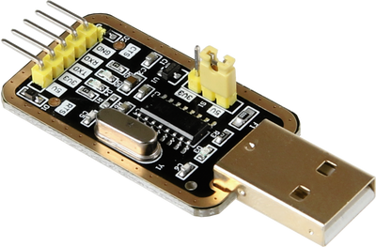
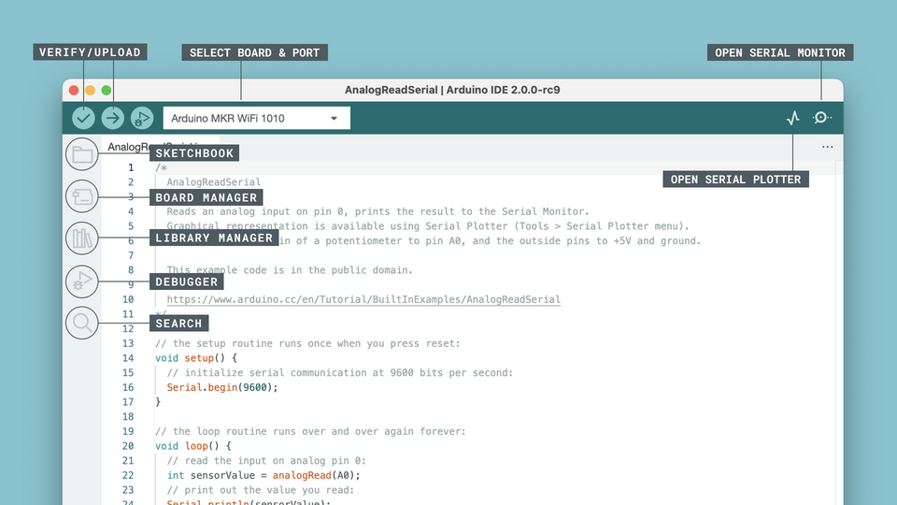
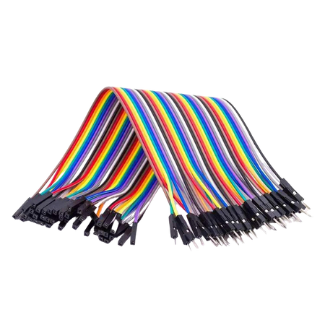
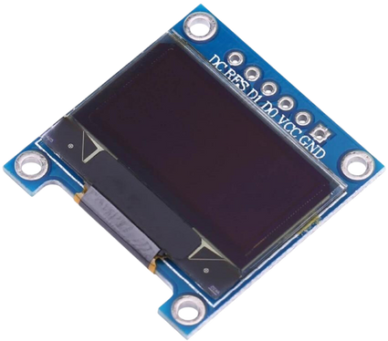
BUCO PI
Software & Hardware requirements
BATSTATEU CUSTOMIZABLE AND OPEN PLATFORM FOR IOT
Software
Hardware

Slide 10

LIVE DEMO: OLED DISPLAY CODING USING BUCO PI

Slide 11
LIVE DEMO: WEBSERVER CODING USING BUCO PI

Slide 12

HANDS ON EXPERIENCE

Slide 13


Congratulations!
You've Completed the Basics and Simple Demo for BUCO PI.

